Slide 1
Main Drivers of HDB Resale Price
By -Shreyas (U2121341J),
Lee Bohua (U2122595D) ,
Kim Seo Jin (U2122248G)

Slide 2
TABLE OF CONTENTS
01
02
03
04
Problem
Definition
Exploratory
Data
Analysis
Model
Training
Overall
Insights
TABLE OF CONTENTS

Slide 3
DATASET USED
Housing Data set
MRT Station coordinates
From data.gov.sg
From kaggle.com
Helper functions for data prep
From kaggle.com
DATASET USED
Notes:
Bo hua i just put down first later u change if wrong

Slide 4
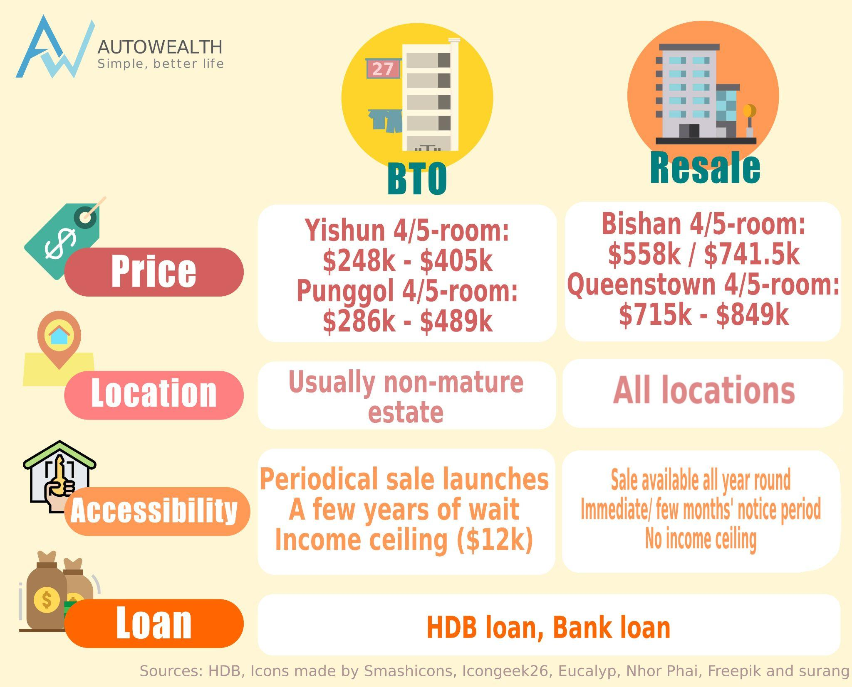
WHAT IS HDB RESALE FLAT?
One of the popular property options. Frequently compared with BTO flats by young Singaporean couple.
Couples who BTO mostly choose to re-sale their HDB flats for profits.
Retrieved from: https://www.autowealth.sg/blog/BTO_vs_Resale_vs_Private_which_is_right_how_to_fund.php
INTRODUCTION
Notes:
Build to order (BTO) flats are HDB flats where construction will begin only if 65-70% of the apartments in the flat have been booked. The construction will be aborted if this requirement is not met.
BTOs have a wait time of three to four years from the date the construction begins. As the start time is dependent on when HDB receives enough applicants, the actual wait time may increase.
BTOs come in 2-rooms, 3-rooms, 4-rooms, 5-rooms and studio apartments.
BTOs also come with home design features. HDB provides the Optional Component Scheme (OCS) and the Universal Design (UD).

Slide 5
MOTIVATION
As university students, housing will soon be our concern as we graduate and step into workforce.
HDB BTO flats, is seen as an affordable option, and is good investment when we resell it in the future
Through this project, we hope to make a more wise and informed choice on housing, by investigating more about HDB resale price so that we can maximise our profits when we re-sell the HDB flats after we BTO
INTRODUCTION - MOTIVATION

Slide 6
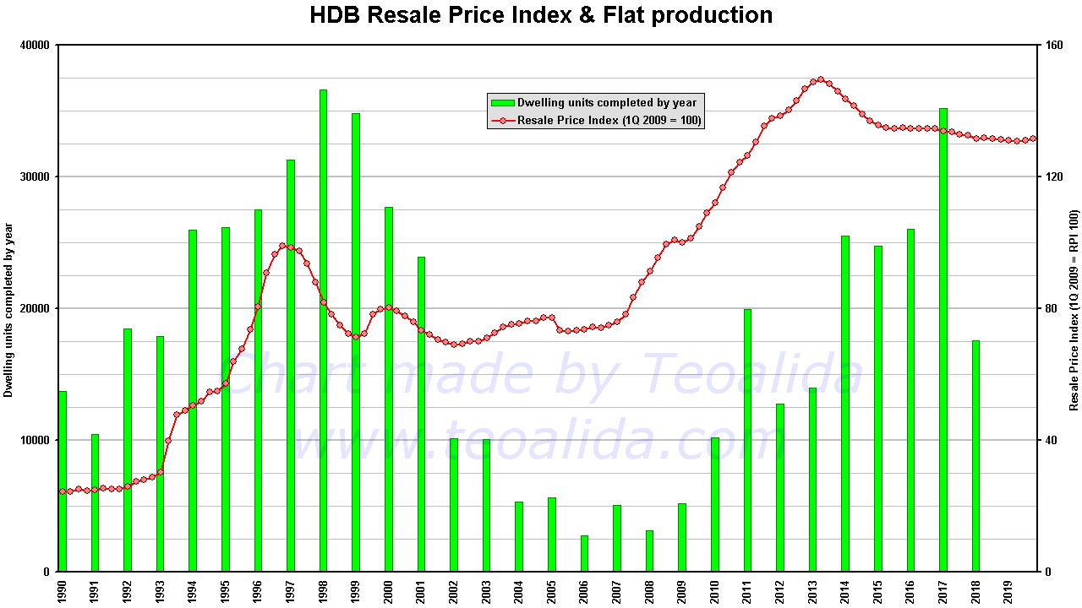
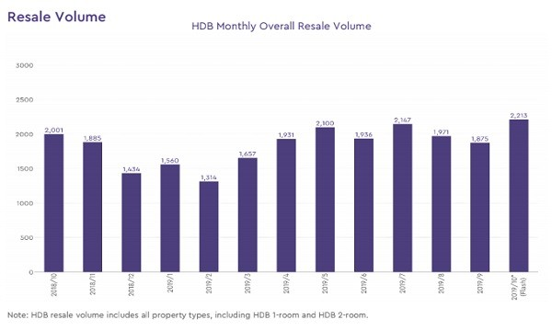
The HDB Resale Price Index has increased drastically over the years.
BUT, the volume of HDB flat resale increase by 18% to 2,213 units in October 2019, according to the SRX Property Price Index.
Retrieved from: https://www.teoalida.com/singapore/hdbprices/
INTRODUCTION
Retrieved from: https://sbr.com.sg/residential-property/news/hdb-resale-volume-rose-18-2213-in-october

Slide 7
PROBLEM DEFINITION
What are the main drivers of HDB resale price, and what should we look out for to maximise the value?
PROBLEM DEFINITION
Notes:
Using HDB Dataset + (other dataset to determine distance etc), predict the resale price of current Built to Order (BTO) flats. So individuals looking to plan for the BTO with best Return on Investment (ROI) can make a more informed choice on which BTO to pick

Slide 8
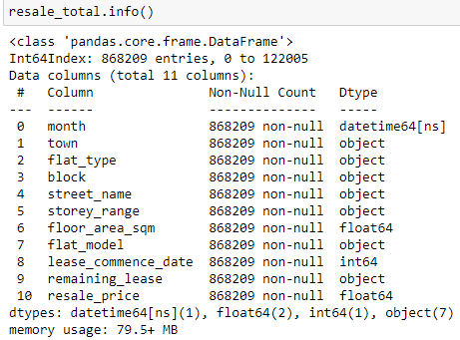
DATA CLEANING
DATA CLEANING

Slide 9
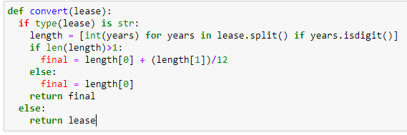
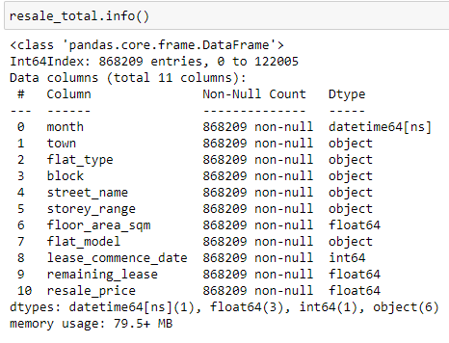

CONVERTING REMAINING LEASE
Used a helper function to convert the remaining lease from strings to integers
DATA CLEANING - CONVERTING REMAINING LEASE

Slide 10
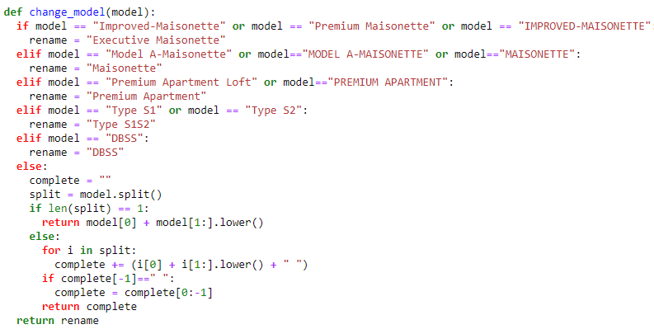
CHANGING NAMES
Renamed flat model duplicates as some are not being built anymore
DATA CLEANING - CHANGING NAMES

Slide 11
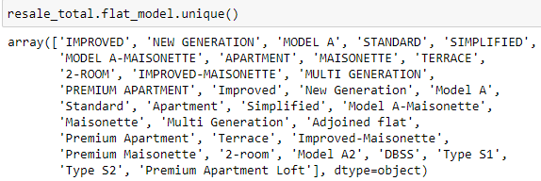
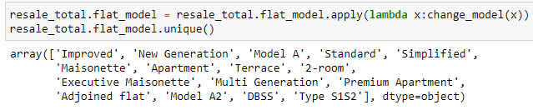
BEFORE
AFTER
DATA CLEANING - CHANGING NAMES

Slide 12
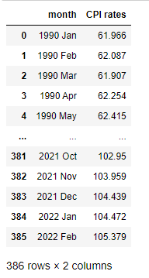
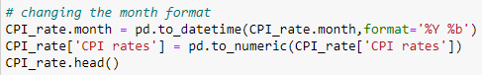
ADJUSTING RESALE PRICES
Adjusted according to CPI rates with reference to 2019 from singstat.gov.sg
Converted to month to datetime format
DATA CLEANING - ADJUSTING RESALE PRICES

Slide 13
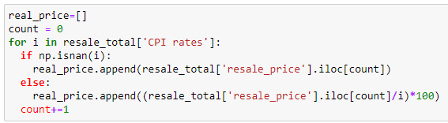
Created a new column called the real price which is price after inflation
Had to remove rows with march from our housing dataset
DATA CLEANING - ADJUSTING RESALE PRICES

Slide 14
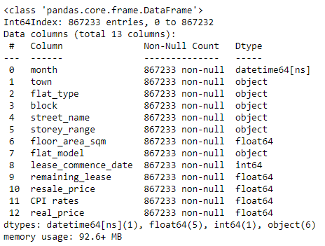
Information on Dataset after Data Cleaning
DATA CLEANING - ADJUSTING RESALE PRICES

Slide 15
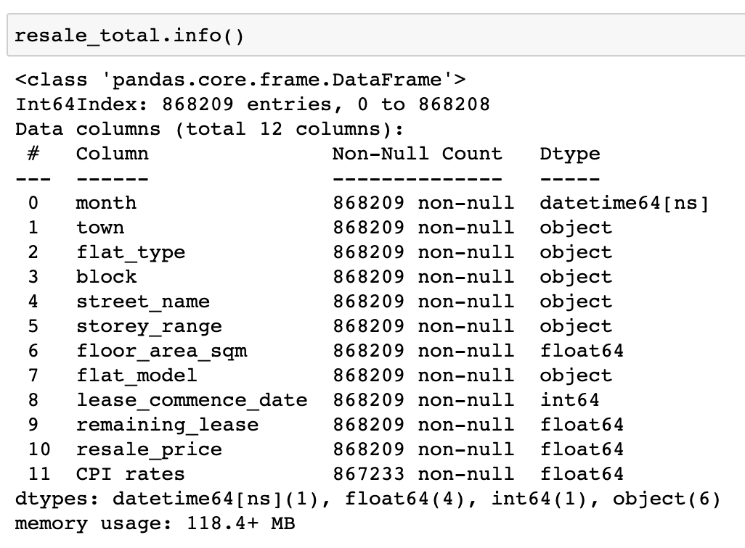
EXPLORATORY DATA ANALYSIS
We differentiated numerical and categorical variables in resale_total dataset into separate datasets
EXPLORATORY DATA ANALYSIS

Slide 16
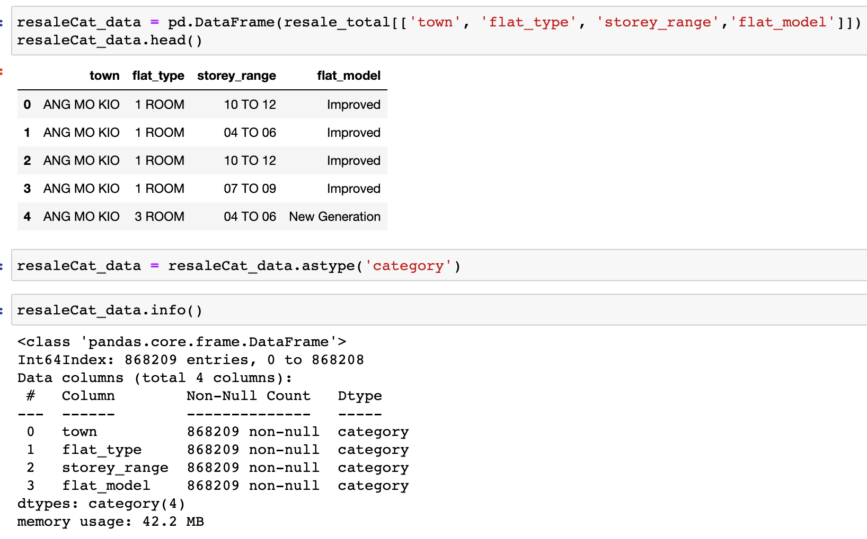
CATEGORICAL VARIABLES
The variables ‘town’, ‘flat_type’, ‘storey_range’ and ‘flat_model’ are in the categorical dataset.
EXPLORATORY DATA ANALYSIS - CATEGORICAL VARIABLES

Slide 17
CATEGORICAL VARIABLES
First, we made a separate dataset named resaleCat_data containing the categorical variables only.
We then fixed the data types of extracted variables ‘category’.
EXPLORATORY DATA ANALYSIS - CATEGORICAL VARIABLES

Slide 18
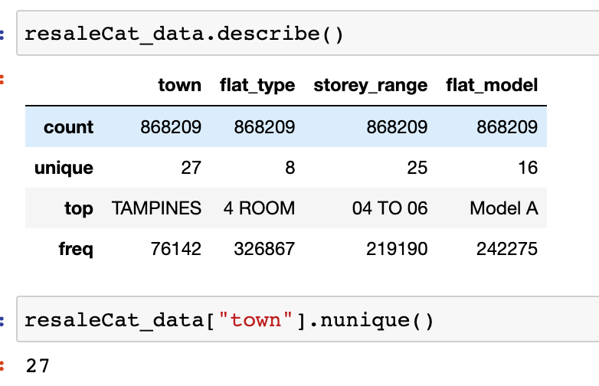
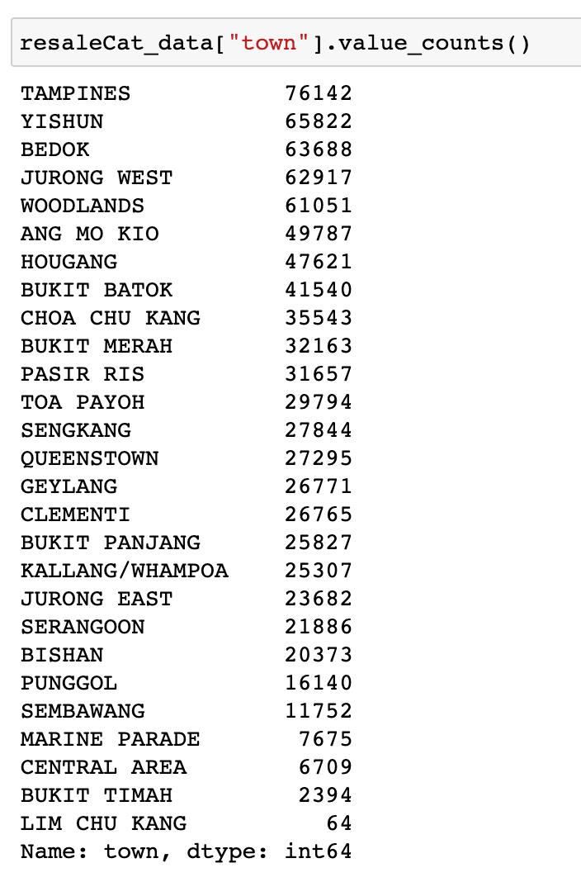
From the describe table, ‘town’ has the highest number of level as a categorical variable, with total value of 27.
This means ‘town’ has most number of unique items, its count being 27.
EXPLORATORY DATA ANALYSIS - CATEGORICAL VARIABLES

Slide 19
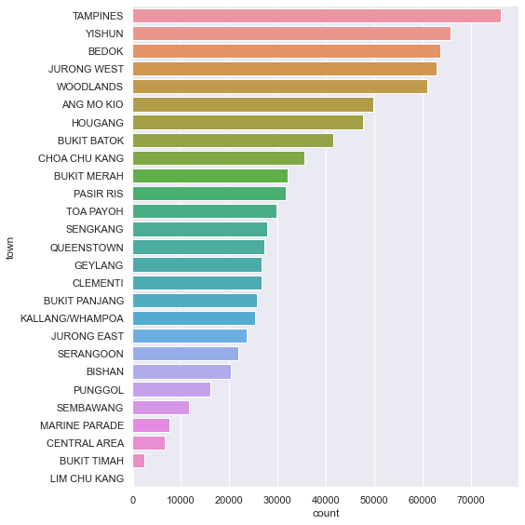
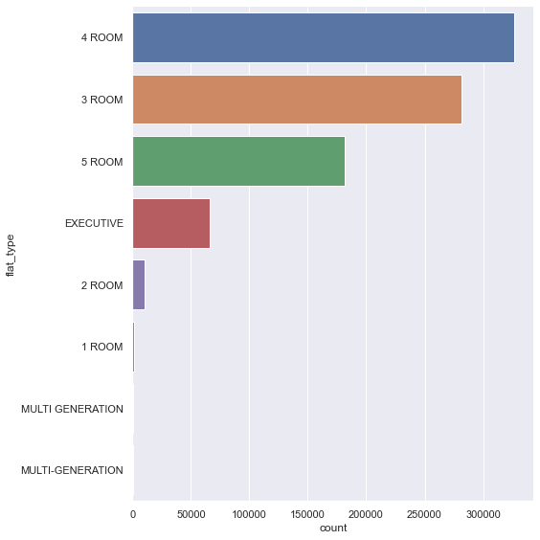
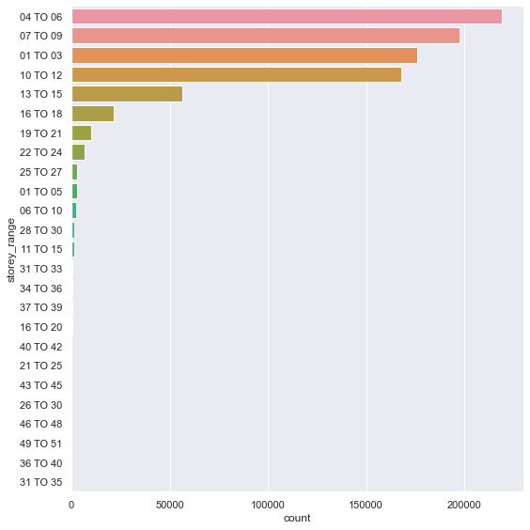
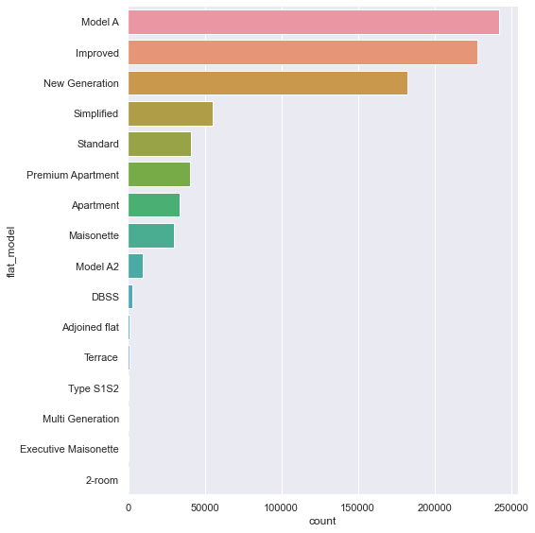
FLAT TYPE
TOWN
Using the catplot, we can roughly gauge the distribution of data across the levels.
Generally, all variables are represented well, sorted by levels.
STOREY
RANGE
FLAT LEVEL
EXPLORATORY DATA ANALYSIS - CATEGORICAL VARIABLES

Slide 20
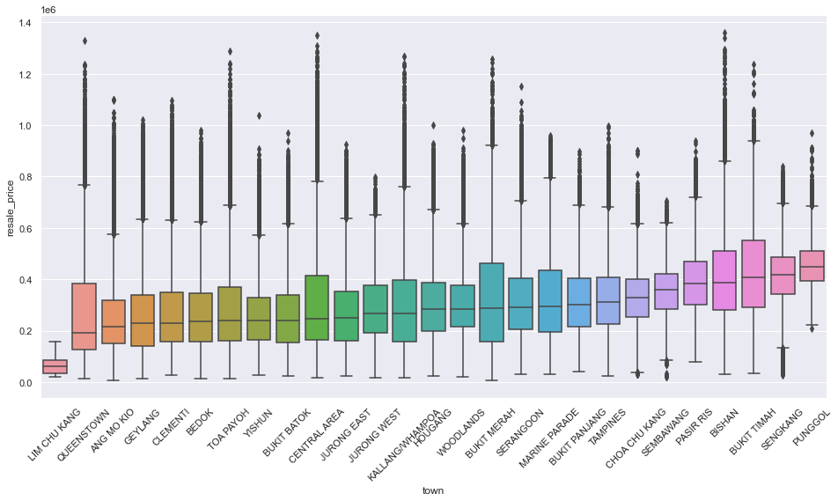
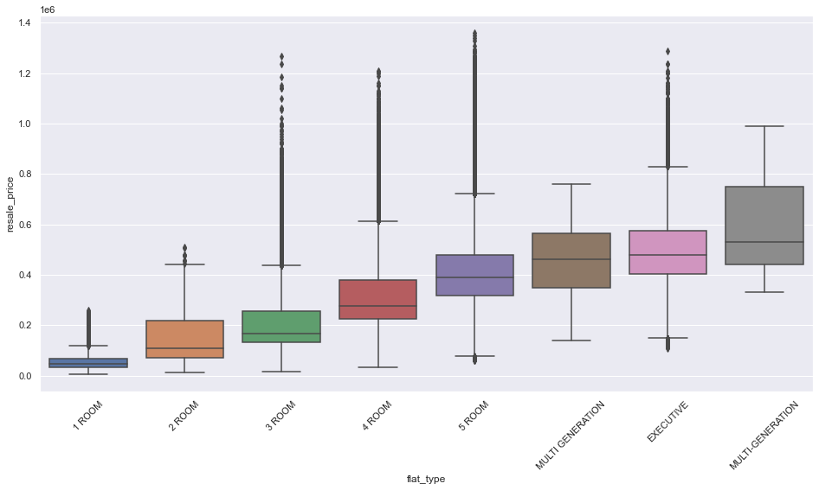
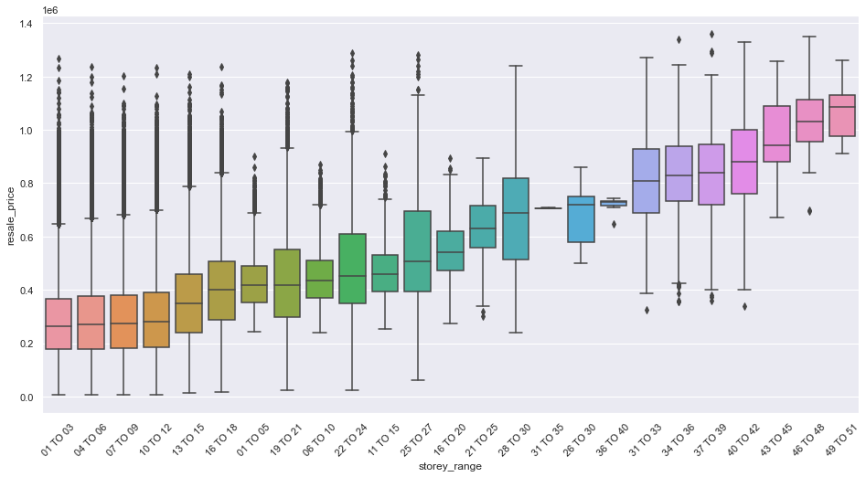
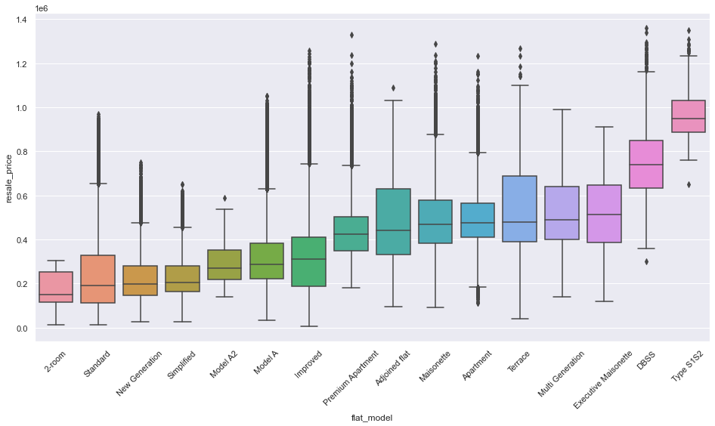
TOWN
FLAT TYPE
A strong increase trend of resale price with increase in storey range and flat model.
The highest variation in resale price is caused by storey range.
STOREY RANGE
FLAT LEVEL
EXPLORATORY DATA ANALYSIS - CATEGORICAL VARIABLES
Notes:
Next we would observe the relationship of the variables with the resale price.
We plot a boxplot where Y axis is the resale price and X axis is the variable

Slide 21
OBSERVATION
Which variables would help us predict ‘Resale Price’ in this dataset?
‘Storey range’ and ‘Flat level: Very Important variables as they have highest variation in ‘Resale price’ boxplots across categorical levels.
‘Flat type’: Moderately important variables as there are quite variations in ‘Resale price’ boxplots across categorical levels.
‘Town’: Not clear if it is an important variable as there isn’t much variation in ‘Resale price’ boxplots across categorical levels.
EXPLORATORY DATA ANALYSIS - CATEGORICAL VARIABLES (OBSERVATION)

Slide 22
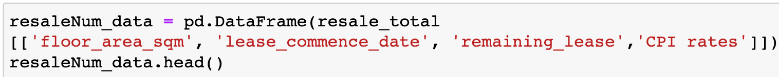
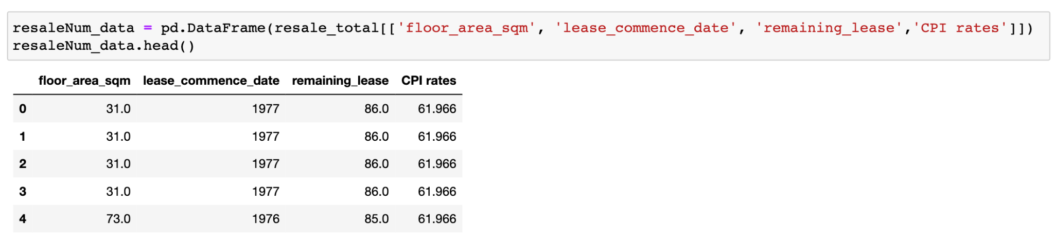
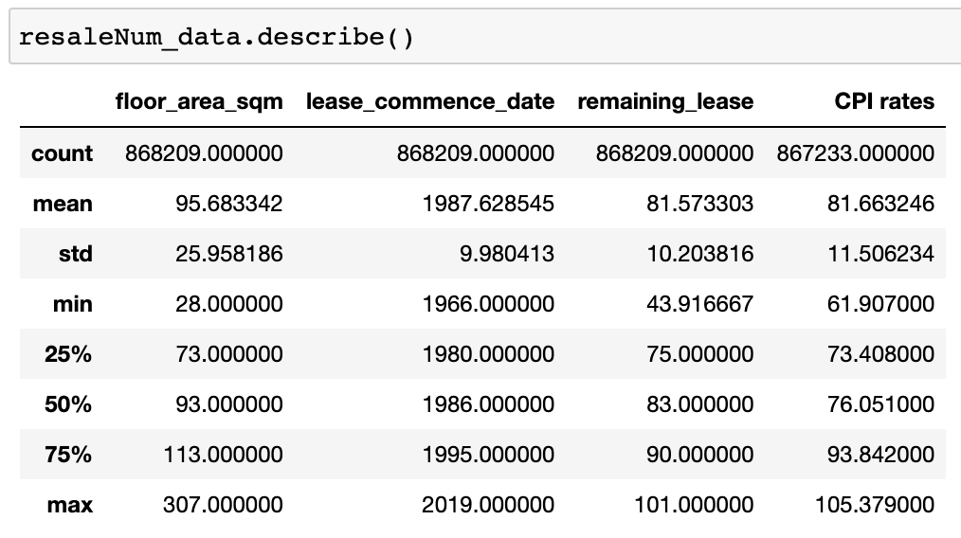
NUMERICAL VARIABLES
Next, we extracted the numerical variables from the resale_total dataset into new dataset named resaleNum_data.
From the describe table, we can observe ‘floor area in square metre’ has greatest standard deviation, indicating the datas are more spread out, and ‘lease commence date’ has lowest standard deviation, indicating data are more clustered to the mean
EXPLORATORY DATA ANALYSIS - NUMERICAL VARIABLES

Slide 23
NUMERICAL VARIABLES
‘Floor_area_sqm’, ‘lease_commence_date’, ‘remaining_lease’ and ‘CPI rates’ are in the numerical dataset
EXPLORATORY DATA ANALYSIS - NUMERICAL VARIABLES

Slide 24
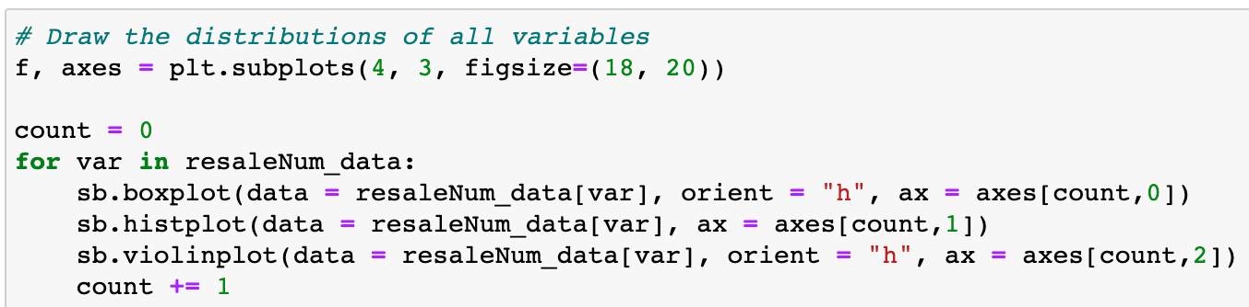
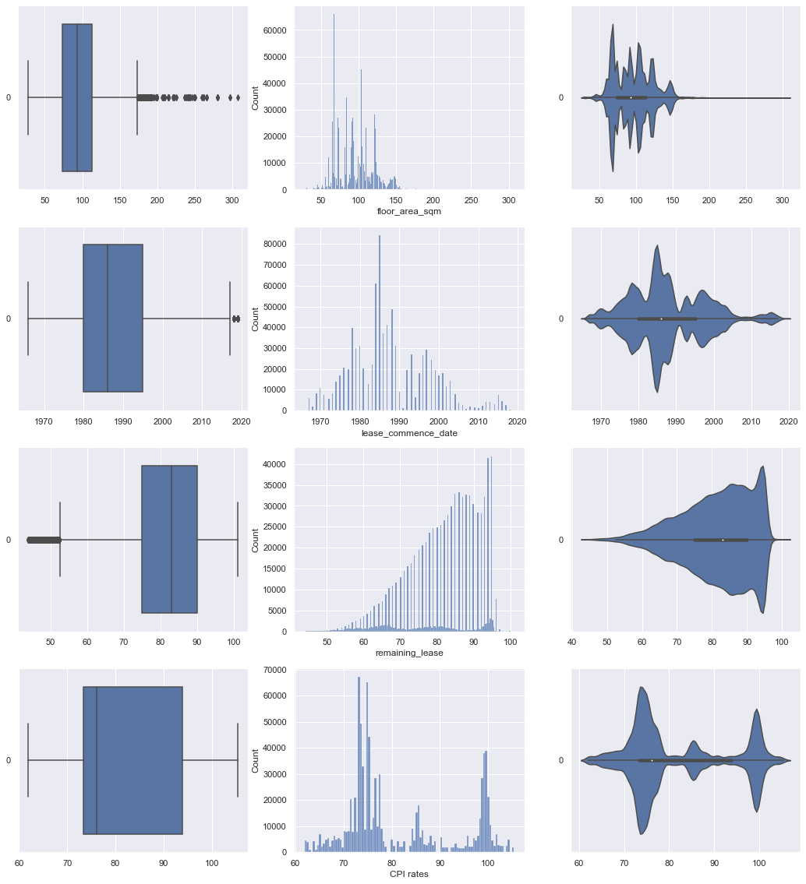
BOXPLOT HISTPLOT VIOLINPLOT
We can see floor_area_sqm seems to have most number of outliers, but there are possibility of ‘remaining_lease’ having more outliers.
‘Remaining_lease’ has maximum skew, while lease_commence_date has minimum skew among the variables.
EXPLORATORY DATA ANALYSIS - NUMERICAL VARIABLES

Slide 25
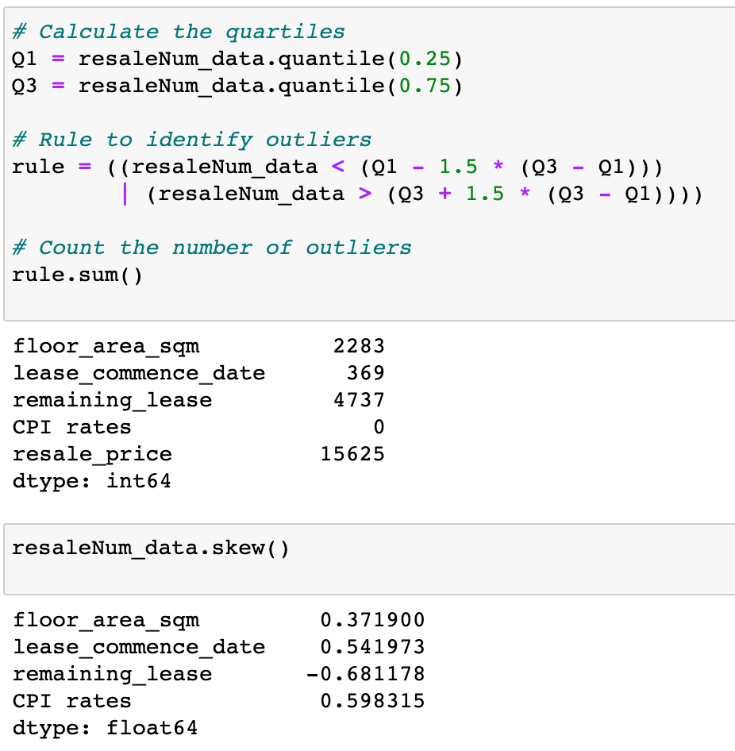
From counting number of outliers from each variables and computing the skewness, we can see in fact ‘remaining_lease’ was the one with most number of outliers and maximum skewness (in terms of magnitude)
Our guess for maximum skewness - CORRECT
Our guess for most number of outliers - WRONG
EXPLORATORY DATA ANALYSIS - NUMERICAL VARIABLES

Slide 26
remaining_lease
floor_area_sqm
VS
Why was the prediction wrong?
The outliers for ‘remaining_lease’ are extremely concentrated in one area, while outliers for ‘floor_area_sqm’ are more spread out, making it difficult to tell there are actually most outliers for ‘remaining_lease’
EXPLORATORY DATA ANALYSIS - NUMERICAL VARIABLES

Slide 27
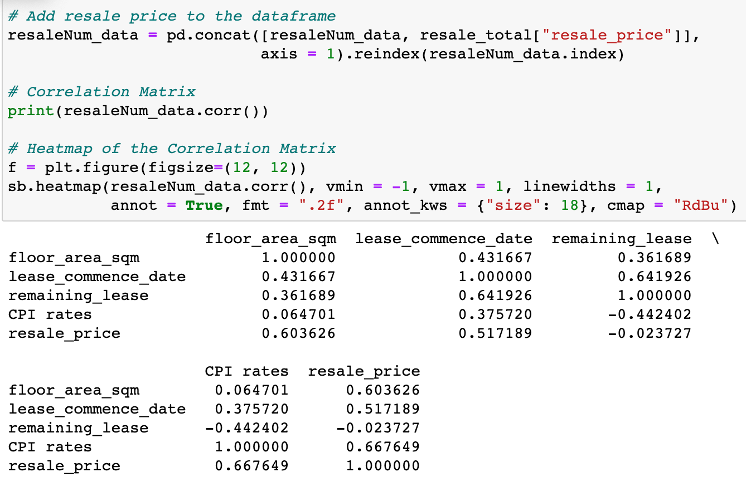
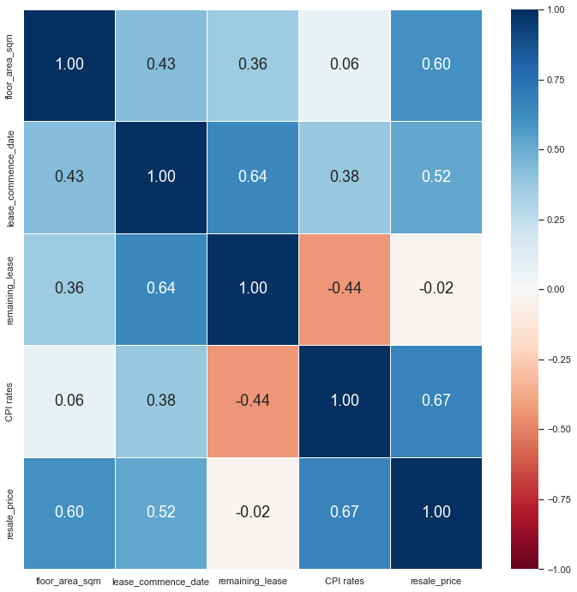
‘CPI rates’ has highest correlation with the resale price and ‘remaining_lease’ has the lowest correlation with the resale price.
EXPLORATORY DATA ANALYSIS - NUMERICAL VARIABLES
Notes:
CPI rates has highest correlation with the resale price and remaining_lease has the lowest correlation with the resale price.
It is interesting and unexpecting to see the low correlation between resale price and remaining lease as we usually expect a house with a longer lease to have higher value as we can stay in the house longer. On the other hand, the CPI rate has the highest correlation with the resale price, as increasing CPI leads to higher inflation, which would eventually lead to rise in resale prices of the houses.

Slide 28
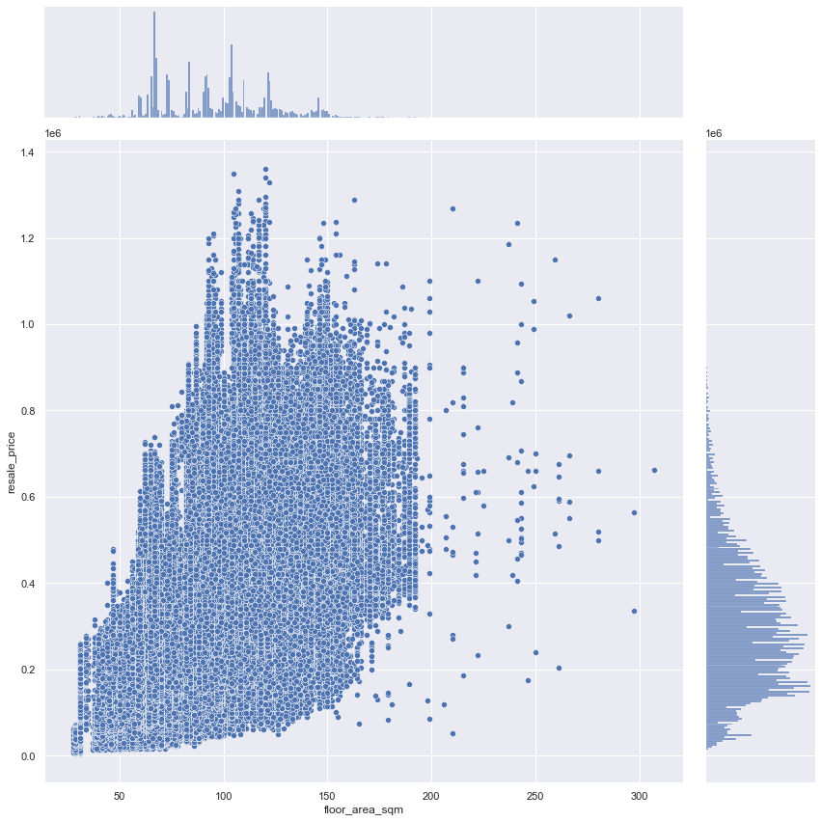
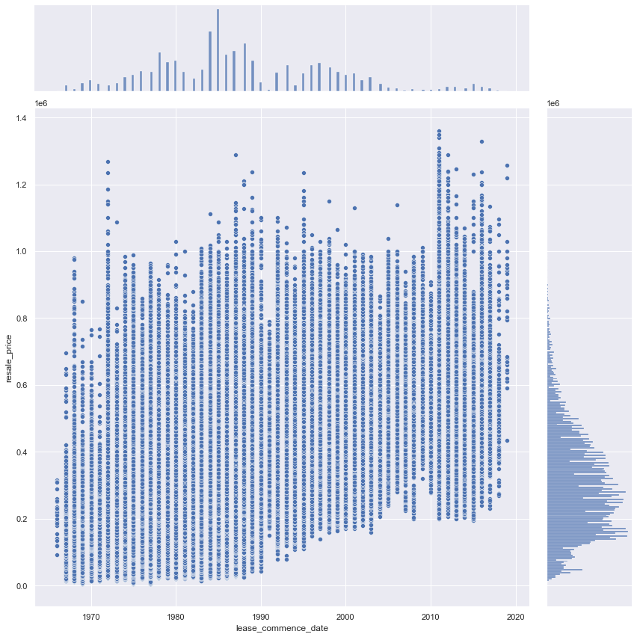
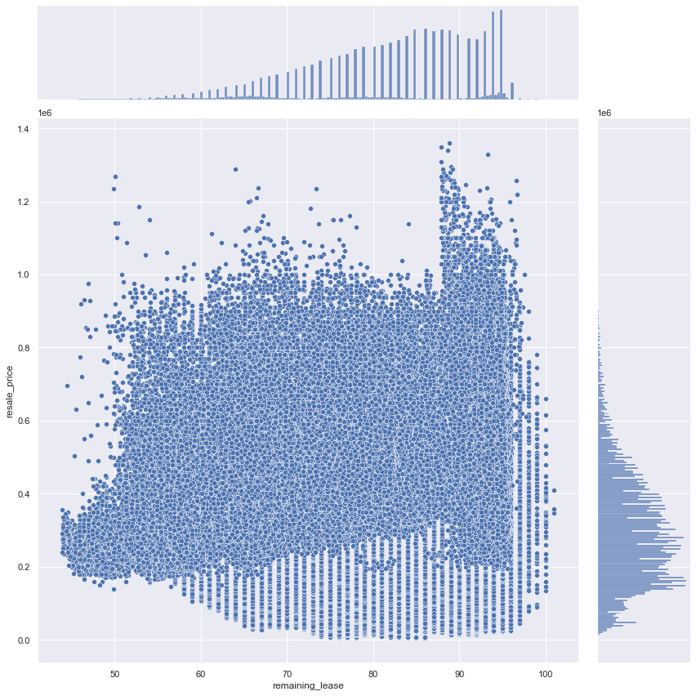
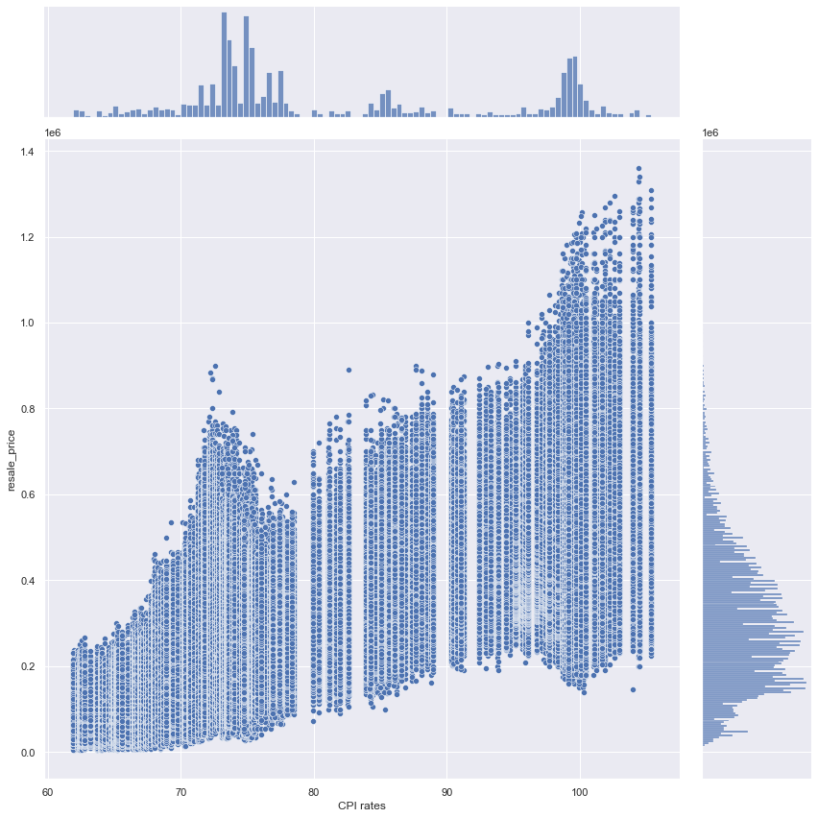
Resale_price
Resale_price
From the diagrams, we can observe ‘CPI rates’ has strongest linearity with ‘resale price’, followed by ‘floor_area_sqm’ and ‘lease_commence date’ and ‘remaining_lease’ has weakest linearity.
floor_square_sqm
lease_commence_date
Resale_price
Resale_price
remaining_lease
CPI rates
EXPLORATORY DATA ANALYSIS - NUMERICAL VARIABLES

Slide 29
OBSERVATION
Which variables would help us predict ‘Resale Price’ in this dataset?
CPI rates: Most important variable, highest correlation of +0.67, and has strongest linearity.
floor_area_sqm and lease_commence date: Important variable as they have high correlation of +0.60 and +0.52 respectively, and strong linearity.
Remaining_lease: Seems to be the least important variable with lowest correlation of -0.02 and weak linear relation
EXPLORATORY DATA ANALYSIS - NUMERICAL VARIABLES (OBSERVATION)

Slide 30
Are these factors the enough to answer our problem statement?
Notes:
- Smoke on why i only included MRT datas after EDA. Say like after EDA we felt that not enough variables or sth

Slide 31
Additional Data-Prep: Distance to nearest MRT
HOW?
Onemap API
Geocoding
Issues:
Huge dataset to parse, time taken
extremely long
How we overcome:
800k -> 9k data reduce time
ADDITIONAL DATA PREPARATION

Slide 32
Data Pre-Processing
01
02
03
04
One Hot- Encoded for town & flat types
Filled in NaN values for distance with mean values
Dropped some features
Split the dataset into Train and Test
TABLE OF CONTENTS

Slide 33
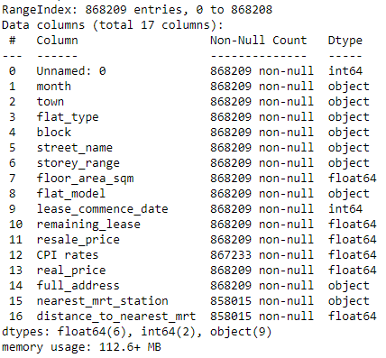
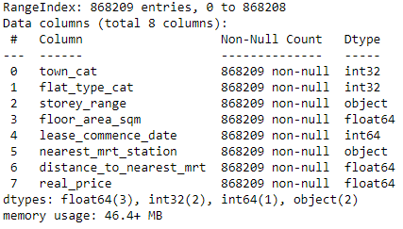
BEFORE
AFTER
DATA PRE-PROCESSING

Slide 34
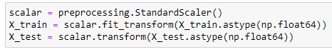
Data Splitting
Split DataSet into a ratio of 0.75 : 0.25 as Training: Test
Applied Standard Scaling to scale both X_train and X_test
DATA PRE-PROCESSING: Splitting of Data

Slide 35
MACHINE LEARNING MODELS USED
K Neighbours Regression
Random Forest
XG Boost
1
2
3
Regression/Classification
Regression/Classification
Regression
ML MODELS USED

Slide 36
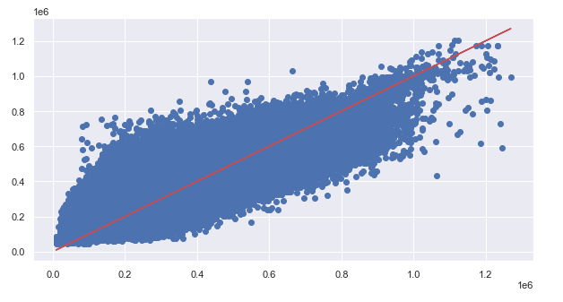
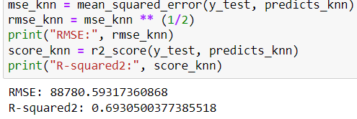
KNEIGHBORS REGRESSOR
HOW?
Sklearn library
Imported KNeighborsRegressor
RESULT:
RMSE: 88780.593
R-squared: 0.69305
TIMING:
13.6 seconds
KNeighbors Regressor

Slide 37
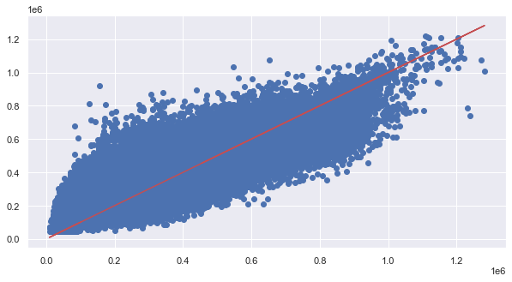
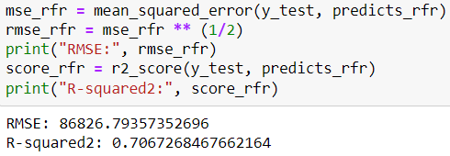
RANDOM FOREST
HOW?
Sklearn library
Imported RandomForestRegressor
RESULT:
RMSE: 86826.79
R-squared: 0.70672
TIMING:
3 min 10 secs
Random Forest

Slide 38
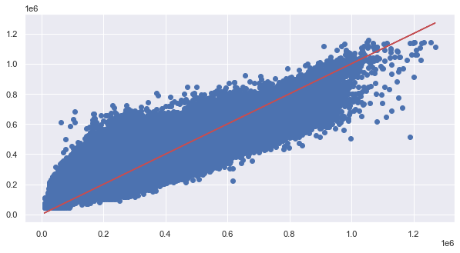
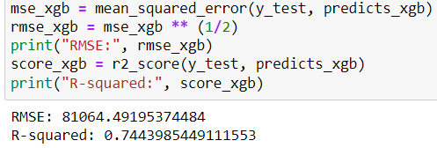
XGBOOST
HOW?
Sklearn library
Imported RandomForestRegressor
RESULT:
RMSE: 81064.49
R-squared: 0.74440
TIMING:
21.8s
Had to convert training data type to Dmatrix
XGBOOST

Slide 39
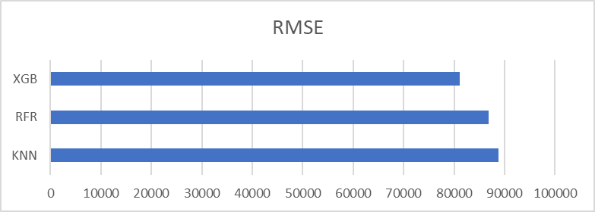
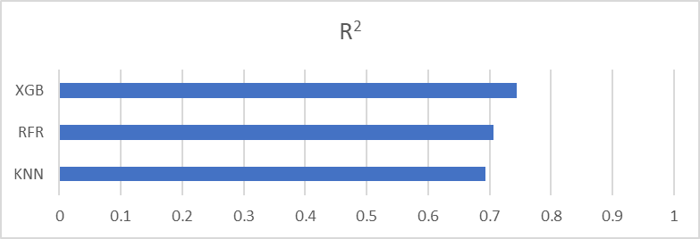
COMPARING THE 3 MODELS
Conclusion
KNN has the best RMSE and R^2
Thus, we would pick this as the best model for our data
How can we further improve on it?
ACCURACY OF EACH ML MODEL
Notes:
Will insert the headers

Slide 40

Improving model: Remove extreme values
Several transactions with resale price < 150k
Even after CPI adjustment
Not possible in today’s housing Market
Huge disparity between actual and predicted data
IMPROVING MODEL - REMOVING EXTREME VALUES

Slide 41
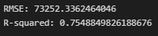
Removed data with resale price < 150k
Re-ran the training using XGboost
Significant drop in RMSE and increase in Explained Variance
A better model
Before
After
IMPROVING MODEL - REMOVING EXTREME VALUES

Slide 42
DATA INSIGHTS
- Remaining lease has minimum correlation with resale price unexpectedly, so it seems to be less important factor affecting HDB resale prices
- Lease commence date and floor area is important variables as they have high correlation and linearity with HDB resale price
- Storey range, flat level and flat type are important variables that cause variations to HDB sale prices, while town seems to be less important
DATA INSIGHTS

Slide 43
Our Recommendations / views
Economic Factors
Grants available
Other Factors
Future development
Resale prices can decline when more BTOs are launched
Proximity housing grant
Additional grant for certain income groups
Consider changes in gov policies, cleanliness of block, etc.
A dashboard/resale price calculator in the future
OUR RECOMMENDATIONS

Slide 44
Our Lessons learnt
Handling large data
New models
Application of Data Science concepts
Using APIs
Github
Factors of HDB resale price
How to increase efficiency?
Random Forest
XGBoost
OUR LESSONS LEARNT

Slide 45
THANK
YOU!

Slide 46
CREDITS
Datasets:
Housing: https://data.gov.sg/dataset/resale-flat-prices
CPI: https://www.singstat.gov.sg/whats-new/latest-news/cpi-highlights
OneMap API: https://developers.onemap.sg/commonapi/search?returnGeom=Y&getAddrDetails=Y&pageNum=1&searchVal=
MRT/LRT: https://www.kaggle.com/datasets/yxlee245/singapore-train-station-coordinates
Helper Functions:
https://www.kaggle.com/code/teyang/drivers-of-hdb-resale-price-and-prediction/notebook
Mentoring:
Our Lab TA, Xiao Bao for being responsive, kind, and patient with our group :)
CREDITS

Slide 47
OTHER CREDITS
Diagrams:
https://www.autowealth.sg/blog/BTO_vs_Resale_vs_Private_which_is_right_how_to_fund.php
https://www.teoalida.com/singapore/hdbprices/
https://sbr.com.sg/residential-property/news/hdb-resale-volume-rose-18-2213-in-october
Slide template:
Template created by Slidesgo, including icons by Flaticon and infographics and images by Freepik
OTHER CREDITS

Slide 48
Thanks!
Do you have any questions?
addyouremail@freepik.com
+91 620 421 838
yourcompany.com
Please keep this slide for attribution

Slide 49
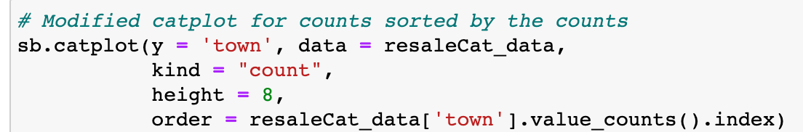

EXPLORATORY DATA ANALYSIS - CATEGORICAL VARIABLES

Slide 50


EXPLORATORY DATA ANALYSIS - CATEGORICAL VARIABLES

Slide 51


EXPLORATORY DATA ANALYSIS - CATEGORICAL VARIABLES

Slide 52

EXPLORATORY DATA ANALYSIS - CATEGORICAL VARIABLES

Slide 53


EXPLORATORY DATA ANALYSIS - CATEGORICAL VARIABLES

